Slide 1
Dynamic Braking of Induction Motors
Slow down a machine by converting kinetic energy stored in the rotating mass to heat energy in the rotor and/or stator windings.
Switch the motor from the line to a braking circuit that causes the motor to behave as a generator with a connected load.

Slide 2
Dynamic Braking of Induction Motors
Methods of braking include DC Injection and Capacitive braking.
Note that there is no “holding” torque at the end of the braking period – need a mechanical brake to hold the shaft.

Slide 3
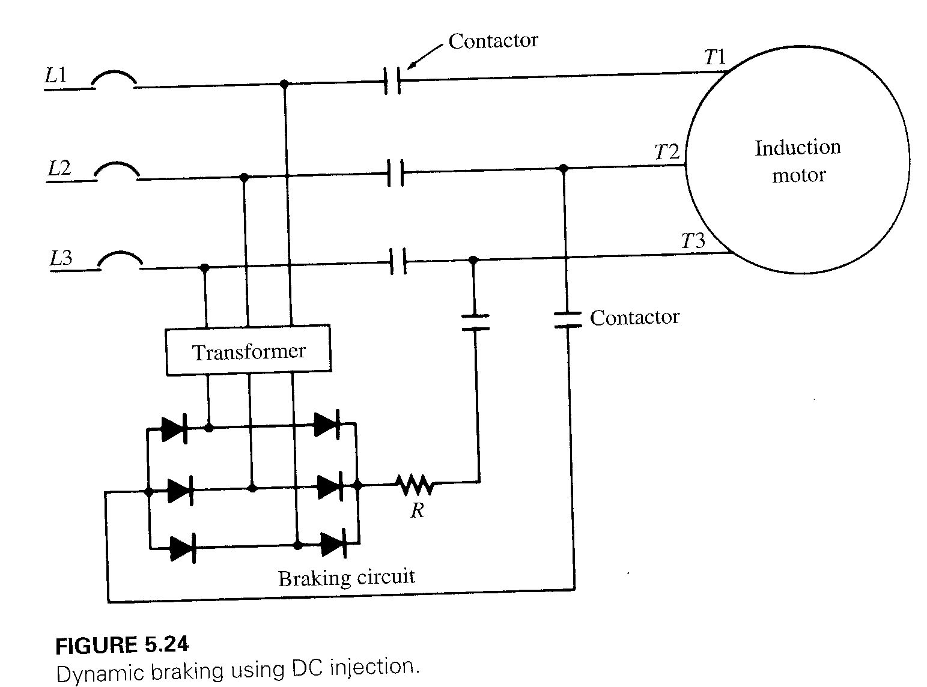
DC Injection Method

Slide 4
DC Injection Method
Disconnect the motor from the line and supply a DC source to any two terminals of the stator through a current-limiting resistance.
The DC voltage sets up a stationary magnetic field that generates a voltage in the rotor windings, dissipating energy as I²R losses, slowing the motor.

Slide 5
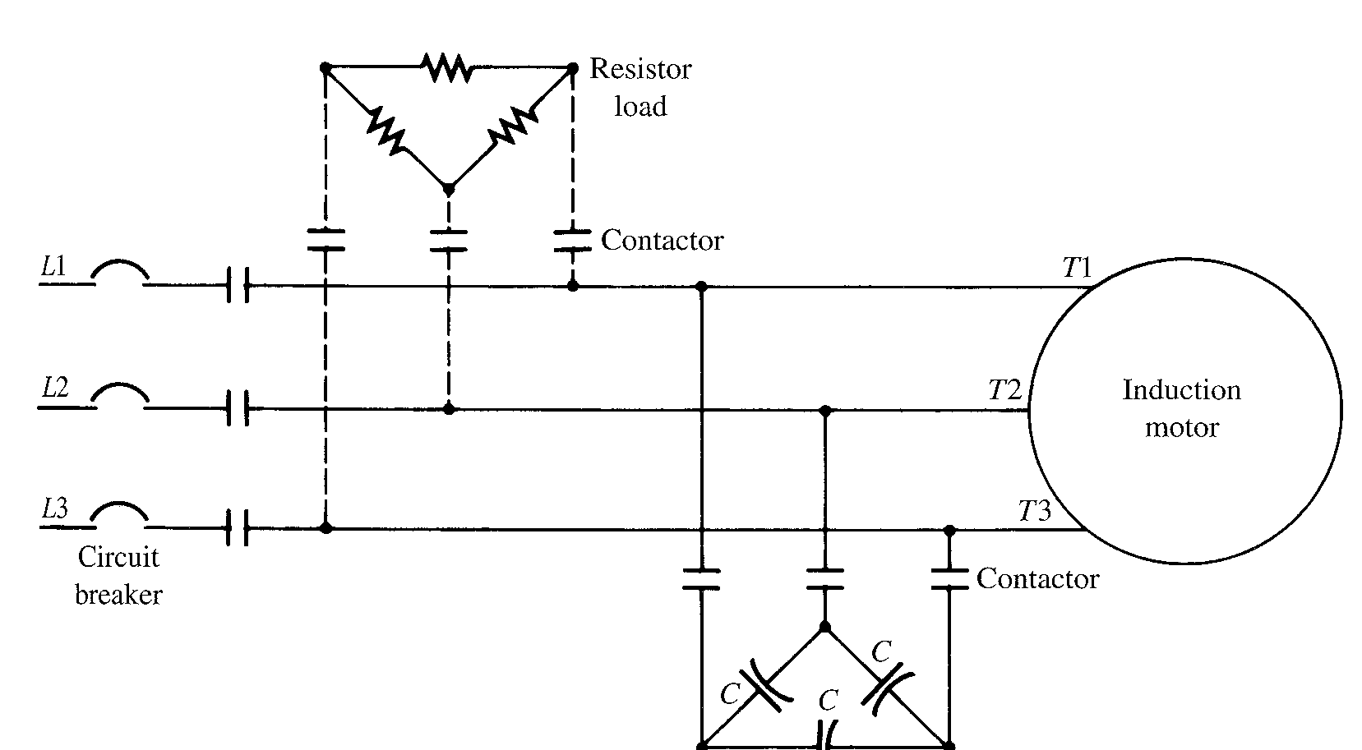
Capacitor Braking Method

Slide 6
Capacitor Braking Method
Disconnect the motor from the line and connect a capacitor bank to the stator terminals.
Motor behaves as a self-excited induction generator.
Rotational energy is dissipated as I²R losses in the rotor and stator windings.
Increase the effect by adding resistor load.

